Slide 1
Forecasting Climate Disasters in the United States
ADM4307 Group 9

Slide 2



Group Introduction
Justin Hay
Mohamed Reda Jahouri
Tijn
4th year BTM and Analytics student
4th year BTM student
Minor in Comp Sci
4th year Intl. Exchange (Econometrics and Operations Research)

Slide 3
Agenda
Conclusion
Monthly Analysis
Data Transformations
Yearly Analysis
Business Problems
Climate Disaster Overview

Slide 4
Climate Disaster Overview

Slide 5
What is a climate / weather disaster?
“A natural disaster that pertains specifically to weather- and climate- related occurrences”

Slide 6
Examples of Weather/Climate Disasters
Droughts
Flooding
Hail
Severe Weather
Tornados
Tropical Cyclones
Wildfires
Winter storms

Slide 7

Why Look at Forecasting Climate Disasters?
Local Economy
Government
Insurance
Communities
Understanding patterns in climate disasters can help mitigate losses to key stakeholders
Ecosystems?

Slide 8
Business Questions

Slide 9
Business Questions
Monthly
Seasonality?
Yearly
Seasonality / Trend?
Is seasonality changing over time?
Is there a correlation between disaster types and cost?
Can we forecast it accurately?
Can we predict multi-year events?
Is there any correlation between costs and counts?
What times of the year are specific disasters more common?
Notes:
Geography is beyond the scope of this assignment, but is still important to note

Slide 10
Business Purposes
Monthly
Planning and preparing resources on a seasonal basis
Yearly
Creating multi-year plans of mitigating losses
Understanding how this planning has changed over time
Viewing climate trends as they relate to climate change
Notes:
Geography is beyond the scope of this assignment, but is still important to note

Slide 11
Explanatory Variables
Counts
Represents the number of climate disasters that have happened in a given time frame
Relevant for two reasons:
Useful for forecasting costs
Helps quantify compound climate disasters
Costs
Represents an aggregation of costs for climate disasters in a given time frame
Relevant to directly assess risks to key stakeholders
Notes:
https://nca2023.globalchange.gov/chapter/focus-on-1/#:~:text=Compound%20events%20result%20from%20the,%2C%20transportation%2C%20food%20systems%2C%20and

Slide 12
Explanatory Variables
Counts
Represents the number of climate disasters that have happened in a given time frame
Relevant for two reasons:
Useful for forecasting costs
Helps quantify compound climate disasters
Costs
Represents an aggregation of costs for climate disasters in a given time frame
Relevant to directly assess risks to key stakeholders
Definition: Compound climate disasters
Multiple events occurring during overlapping periods
Causes an exponential increase in damages, often straining disaster response
Notes:
https://nca2023.globalchange.gov/chapter/focus-on-1/#:~:text=Compound%20events%20result%20from%20the,%2C%20transportation%2C%20food%20systems%2C%20and

Slide 13
Data Transformations

Slide 14
Dataset Information
Name: Weather and Climate Billion-Dollar Disasters to Affect the U.S. from 1980 – 2024
Collected by the National Centers for Environmental Information (NCEI)
Column Values:
Name of Disaster
Type of Disaster
Begin Date
End Date
CPI-Unadjusted Cost (millions of $)
CPI-Adjusted Cost (millions of $)
Deaths
Cost for each disaster is calculated from a wide range of sources
Only data until 2023 is included in analysis
Provides a threshold that defines an event as “extreme”
Allows for modeling how these events increase / decrease over time
Why $1 billion?

Slide 15
Data Formatting - Yearly
Name | Type of Disaster | Start Date | End Date | CPI-Unadjusted Cost | CPI-Adjusted Cost | Deaths
Severe Storms (June 1982) | Severe Storm | 5/31/1982 | 6/10/1982 | $479.9 | $1574.2 | 30
Name | Type of Disaster | Date | Cost | Count
Severe Storms (June 1982) | Severe Storm | 1982 | $1574.2 | 1

Slide 16
Data Formatting - Monthly
Name | Type of Disaster | Start Date | End Date | CPI-Unadjusted Cost | CPI-Adjusted Cost | Deaths
Severe Storms (June 1982) | Severe Storm | 5/31/1982 | 6/10/1982 | $479.9 | $1574.2 | 30
Name | Type of Disaster | Date | Cost | Count
Severe Storms (June 1982) | Severe Storm | May 1982 | $787.1 | 1
Severe Storms (June 1982) | Severe Storm | June 1982 | $787.1 | 1

Slide 17
Dealing with Outliers
We decided on keeping all outliers from both cost and counts
Nearly all cost outliers were associated with tropical storms (hurricanes)
We believe this data is important for forecasting events that only occur once every few years

Slide 18
Dealing with Null / Missing Values
Some time periods did not contain any $1 billion disasters
R disregarded these values when making charts
These values were transformed to equal 0

Slide 19
Monthly Data Analysis

Slide 20
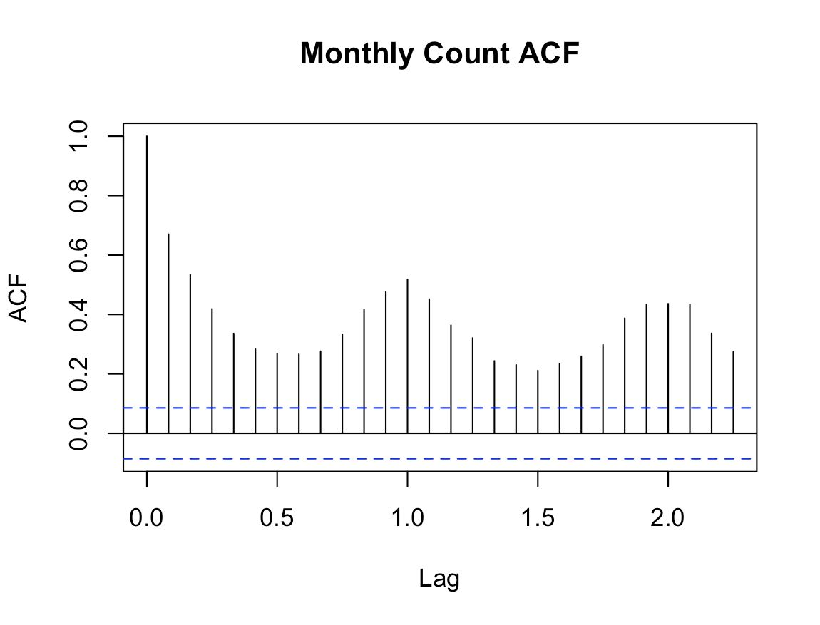
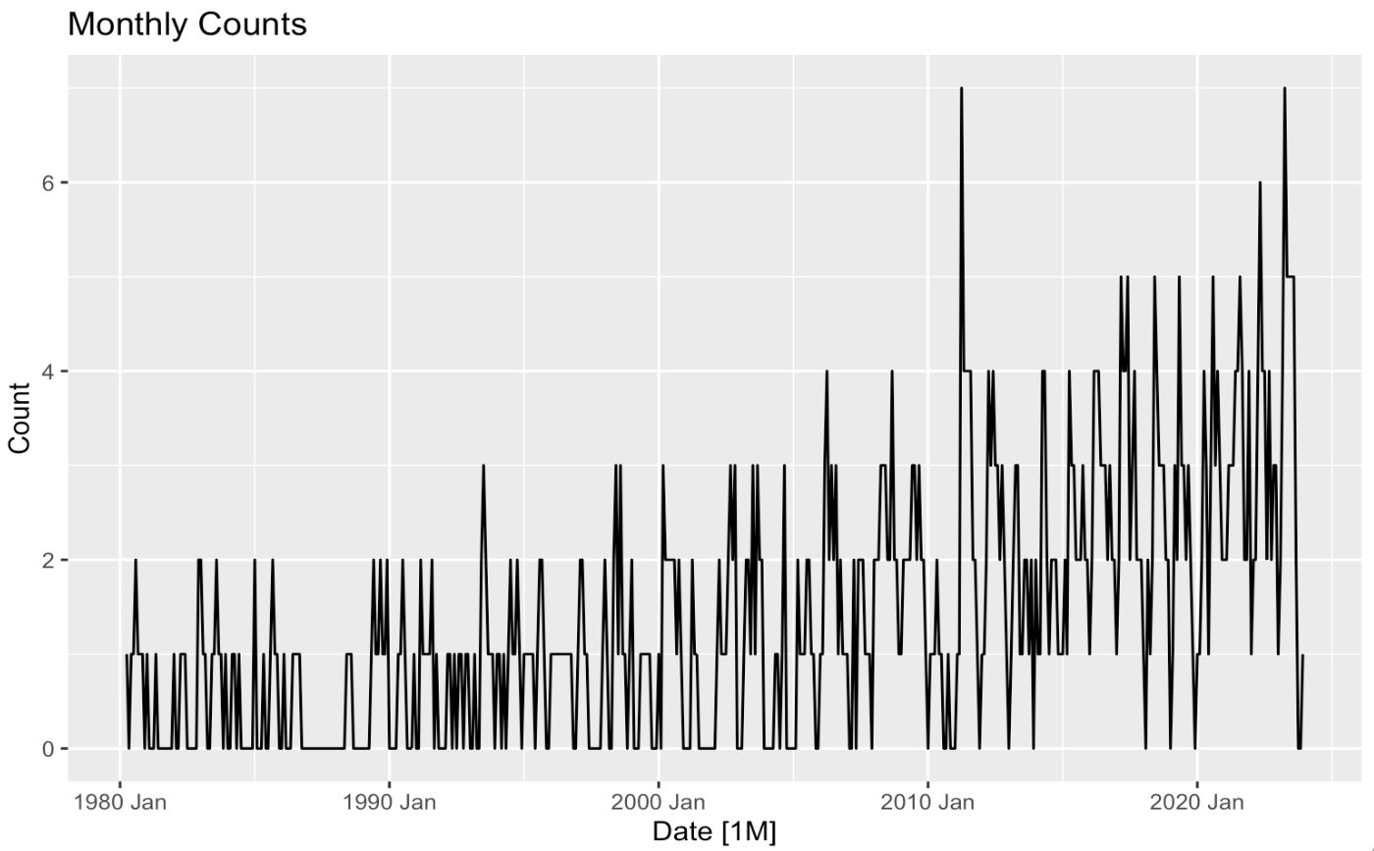
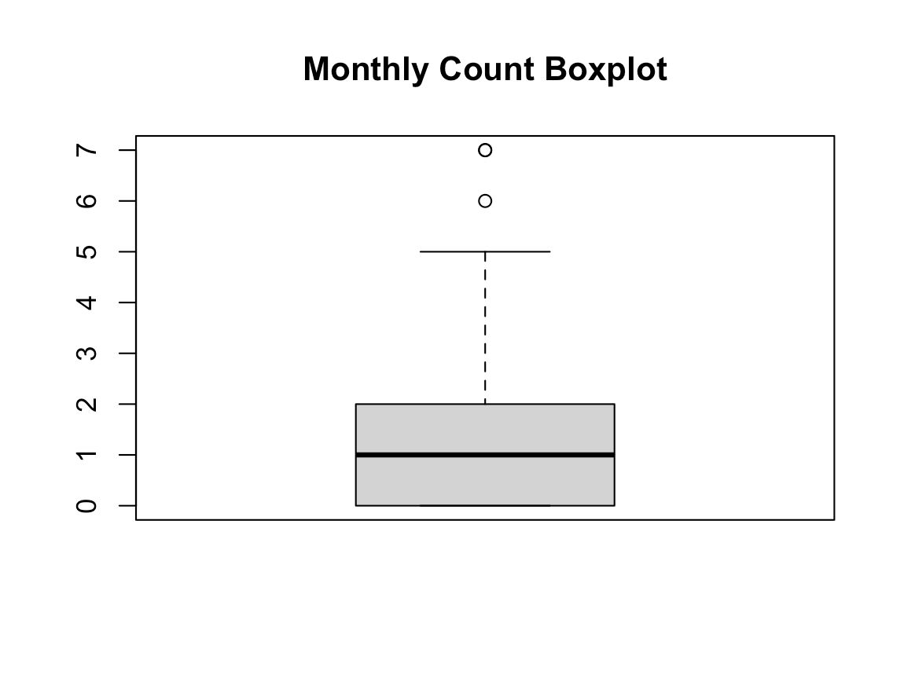
Data Overview - Monthly Counts

Slide 21
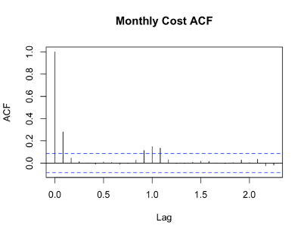
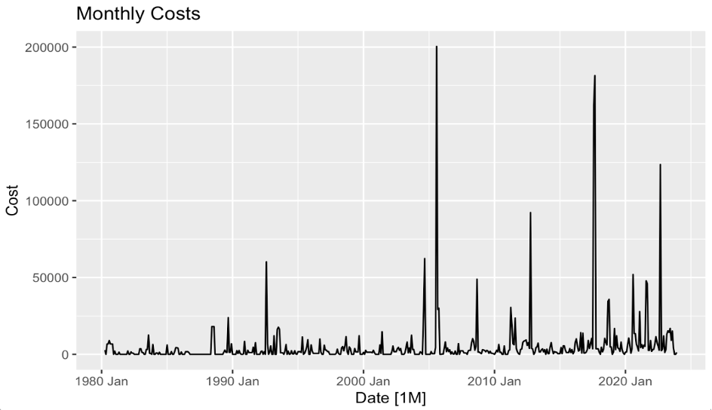
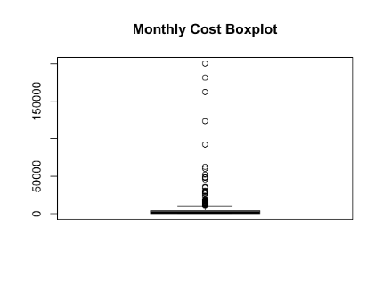
Data Overview – Monthly Costs

Slide 22
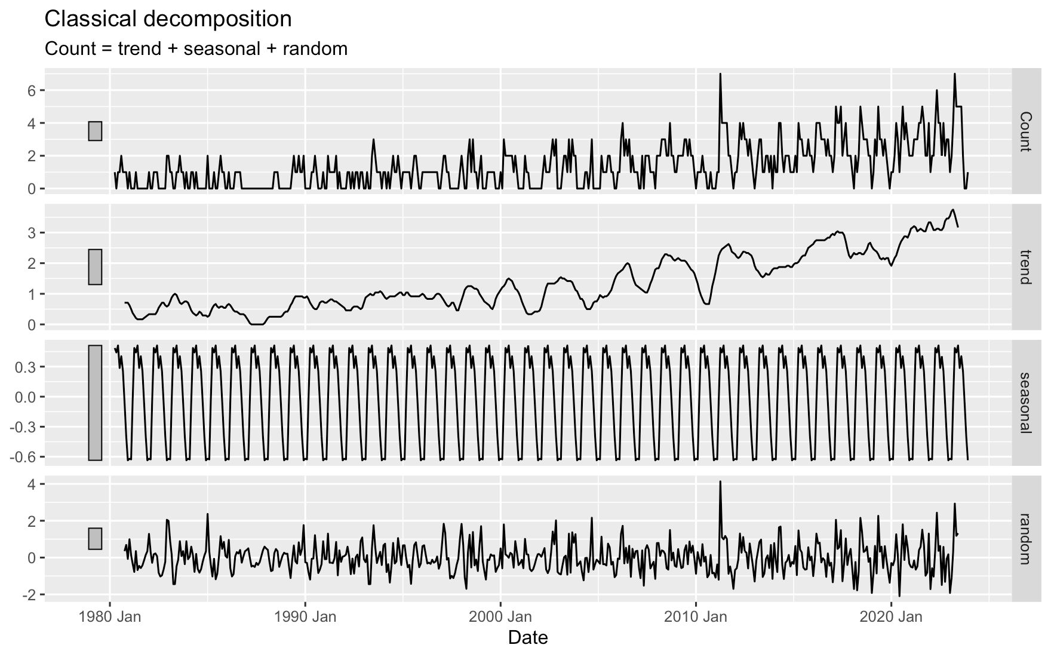
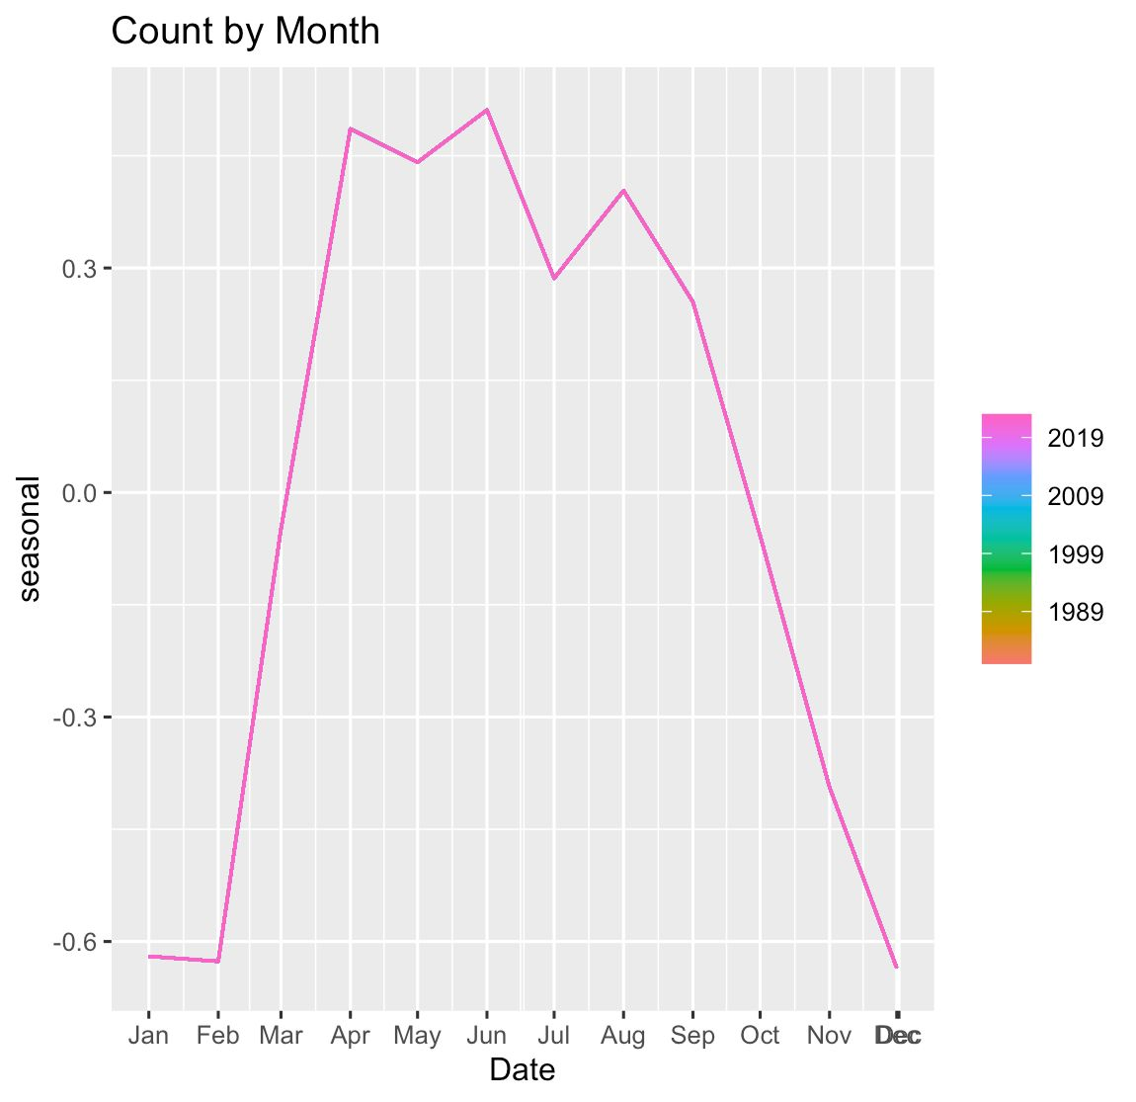
Classical Decomposition – Monthly Counts

Slide 23
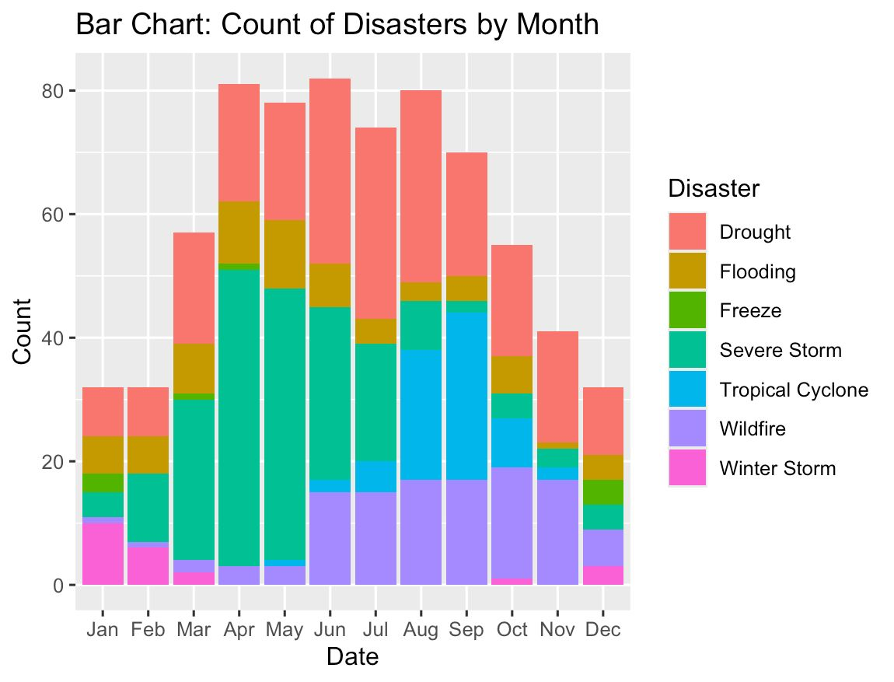
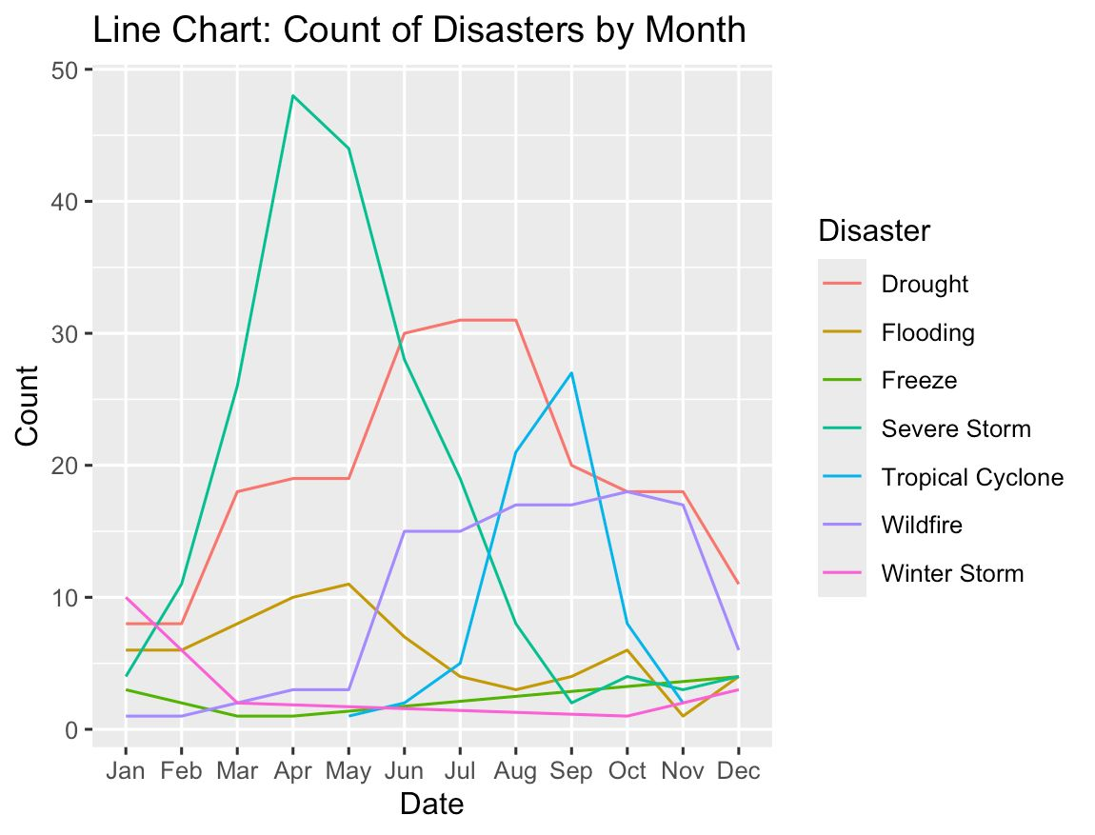
Classical Decomposition – Monthly Counts
What times of year are specific disasters more common?

Slide 24
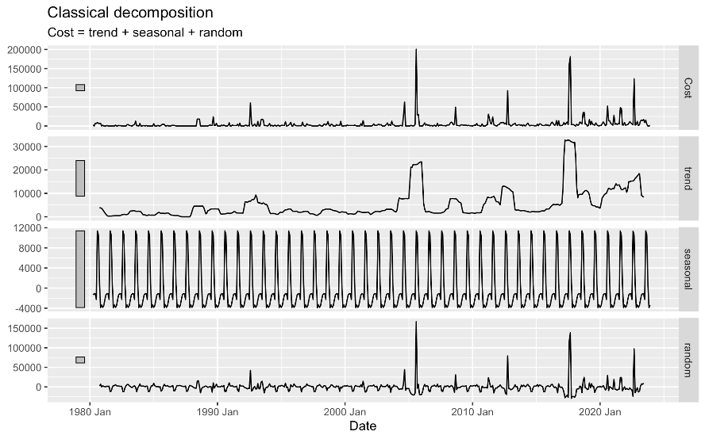
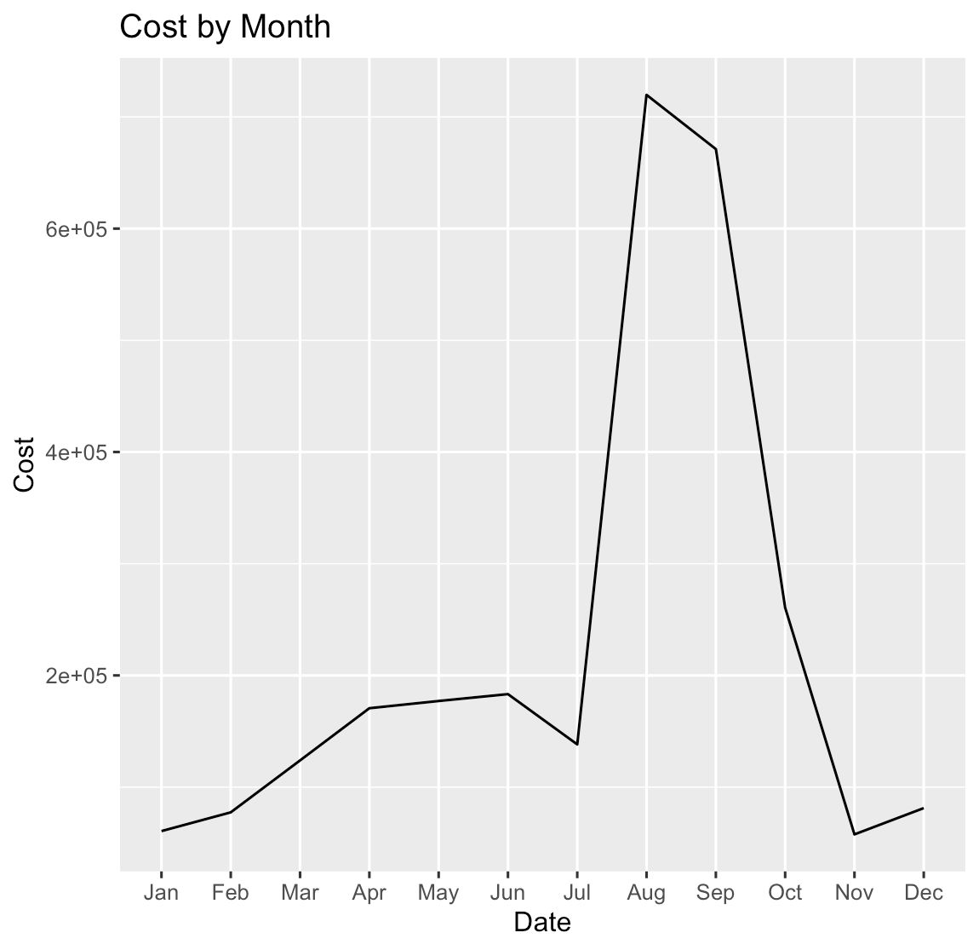
Classical Decomposition – Monthly Costs

Slide 25
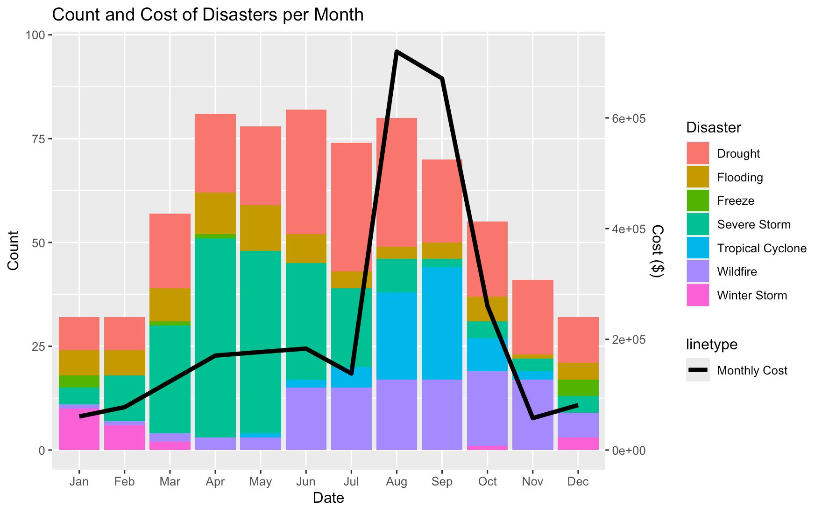
Classical Decomposition
Is there a correlation between disaster types and cost?

Slide 26
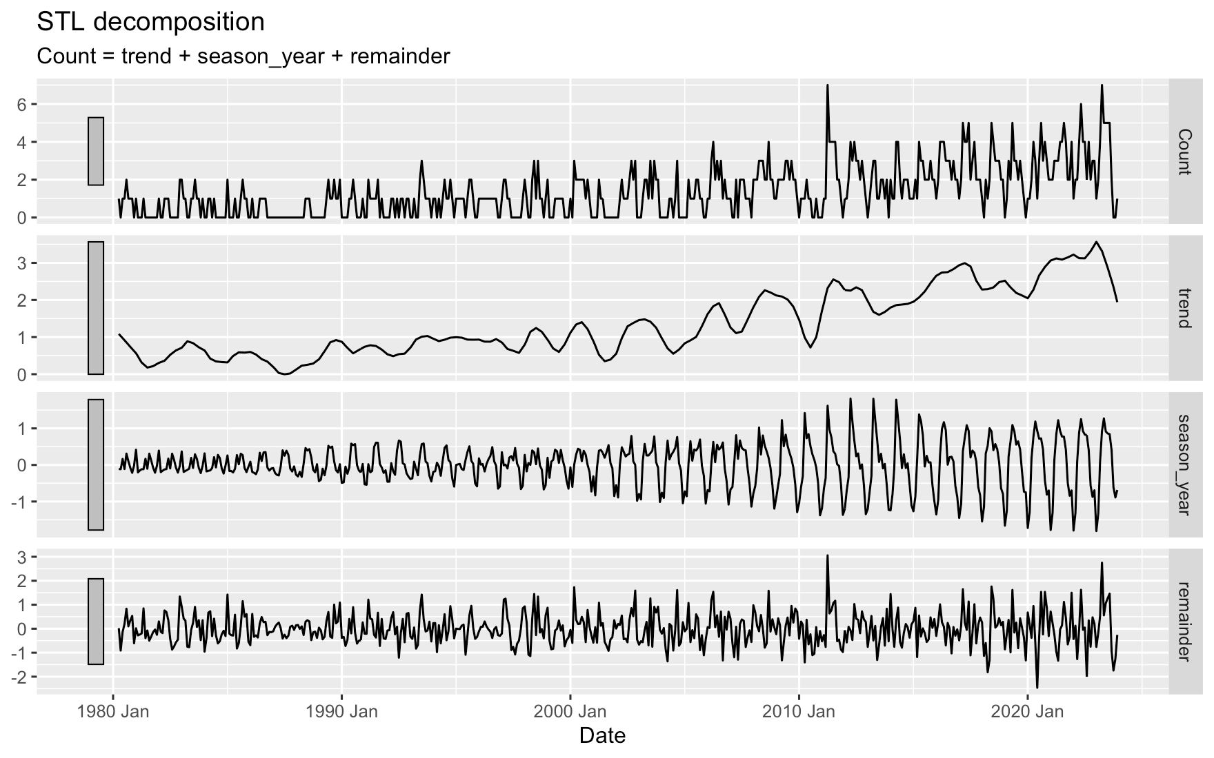
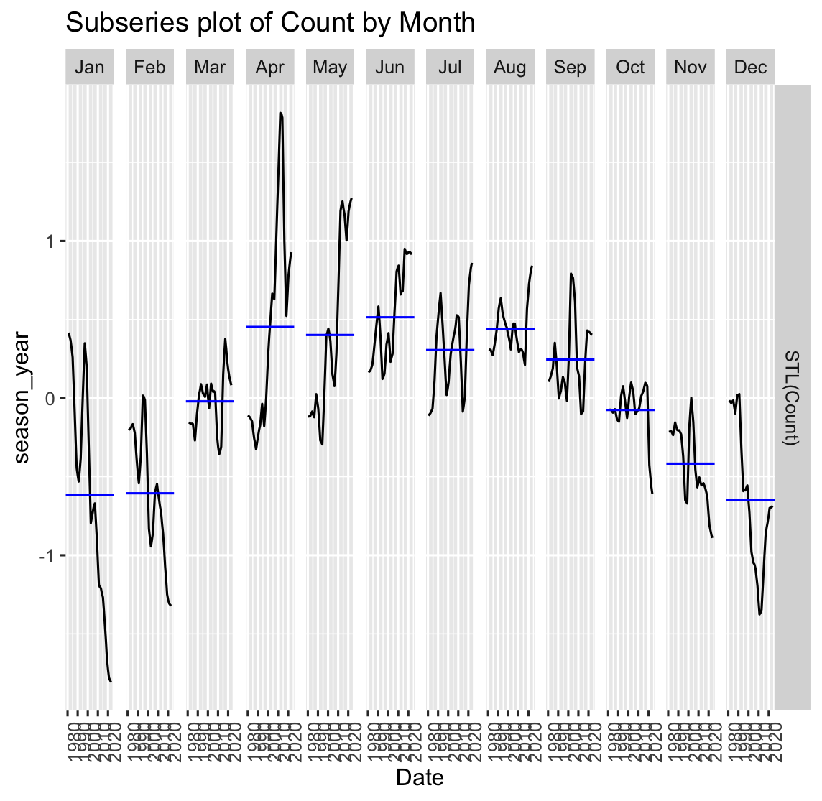
STL Decomposition

Slide 27
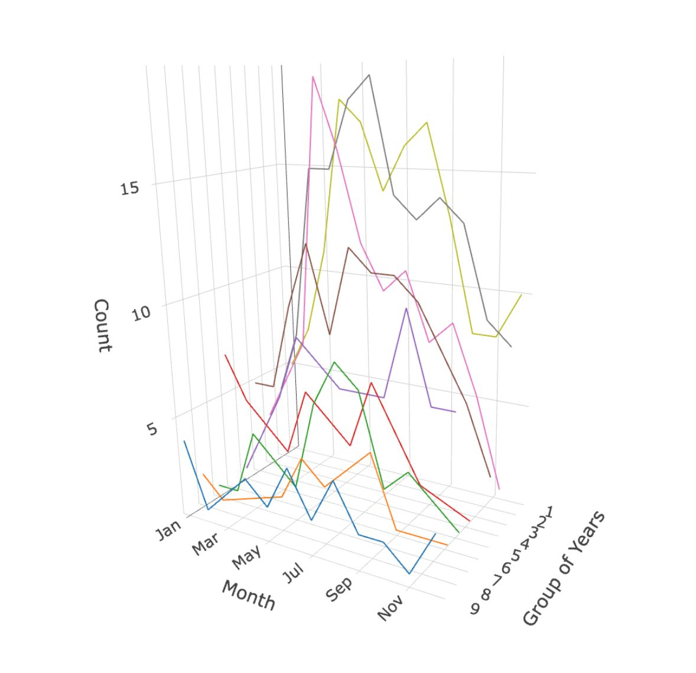
STL Decomposition
Is Seasonality changing over time?
Chart

Slide 28
Yearly Data Analysis: Disaster Counts

Slide 29
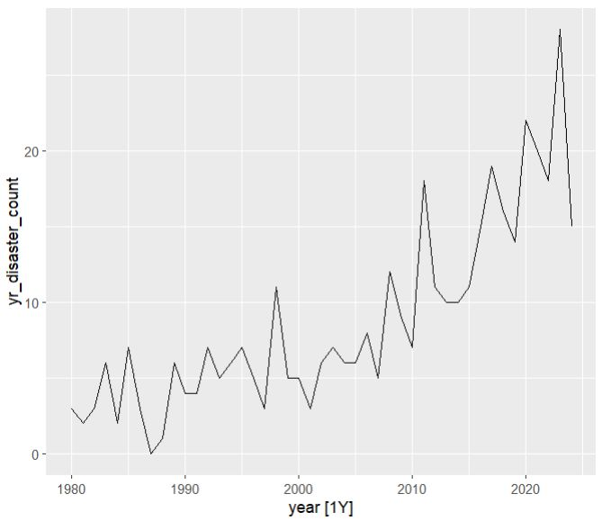
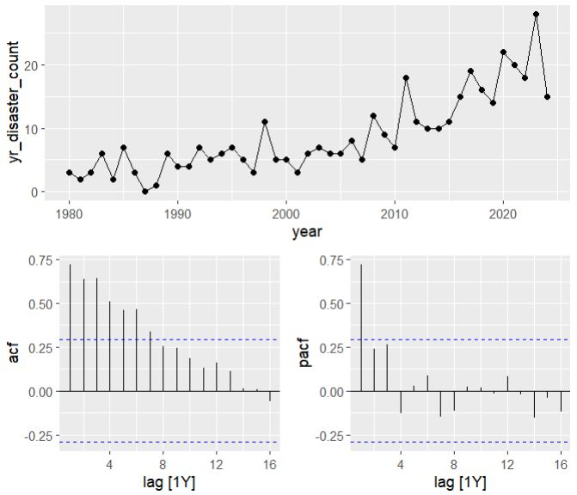
Yearly Counts:

Slide 30
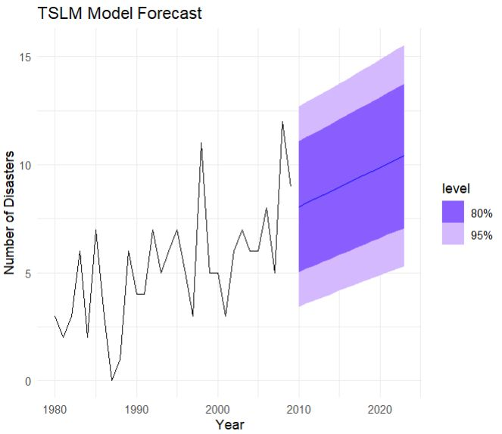
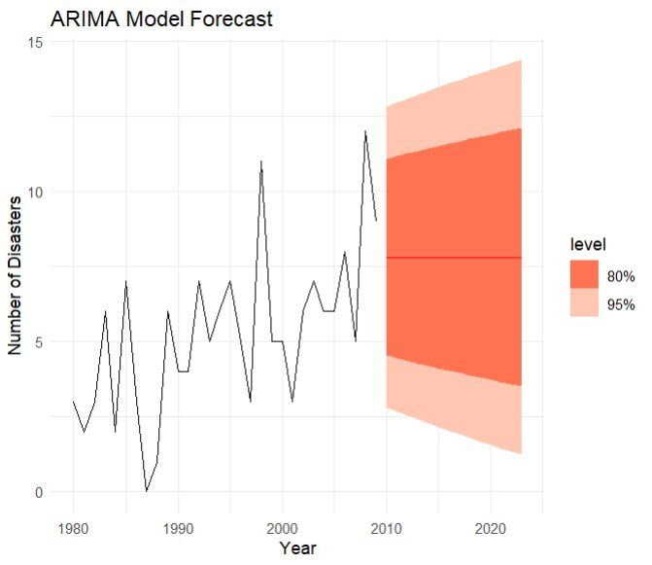
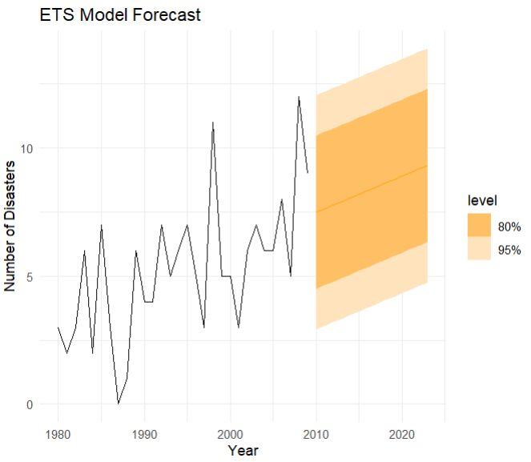
Prediction Models:

Slide 31
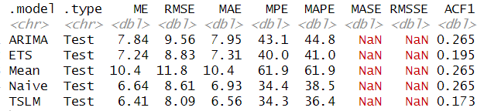
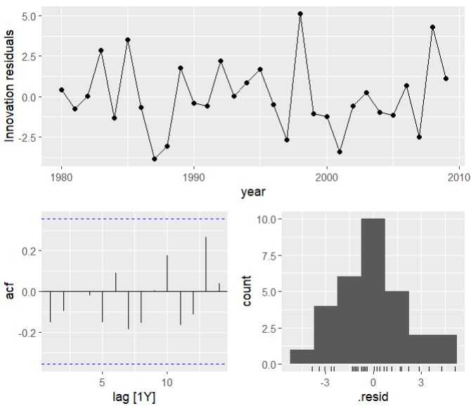
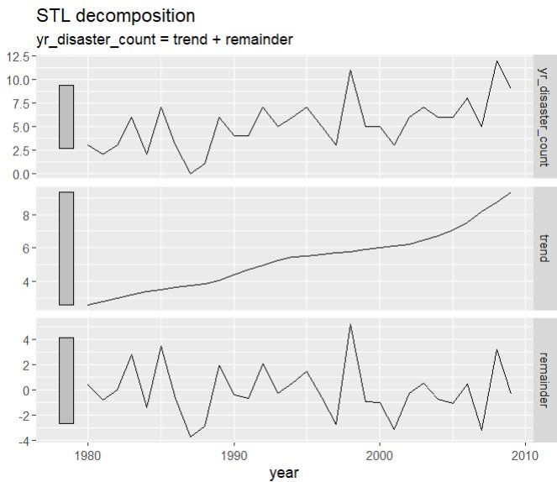

Slide 32
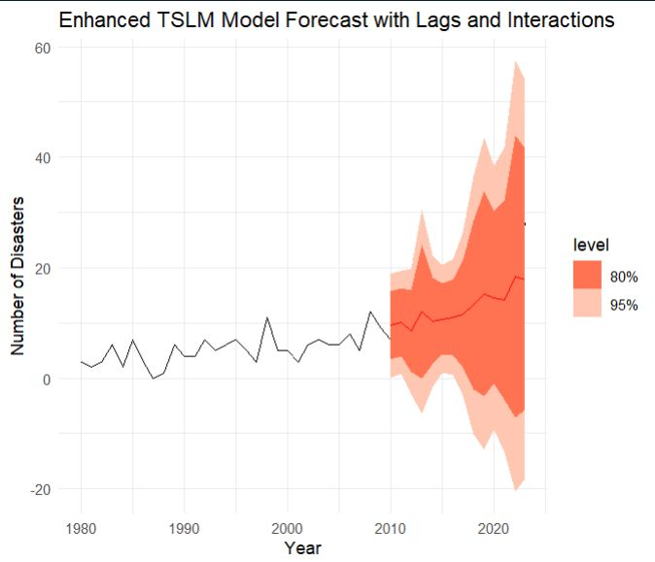
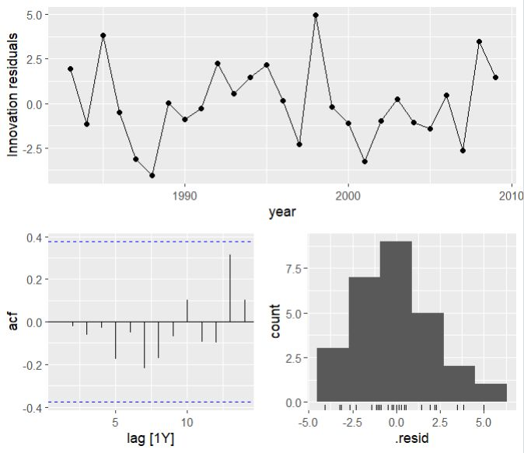
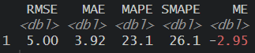
Improved Model (Beyond the scope)
Disaster Count at time t=β0​+β1​⋅(Trend at time t)+β2​⋅(Lag 1 at time t)+β3​⋅(Lag 2 at time t)+β4​⋅(Lag 3 at time t)+β5​⋅(Lag 1 at time t×Trend at time t)+β6​⋅(Lag 2 at time t×Trend at time t)+ϵ_t

Slide 33
Yearly Data Analysis: Disaster Costs

Slide 34
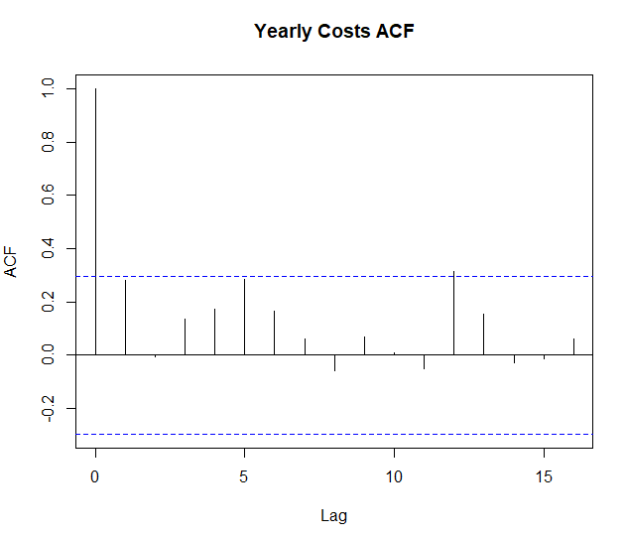
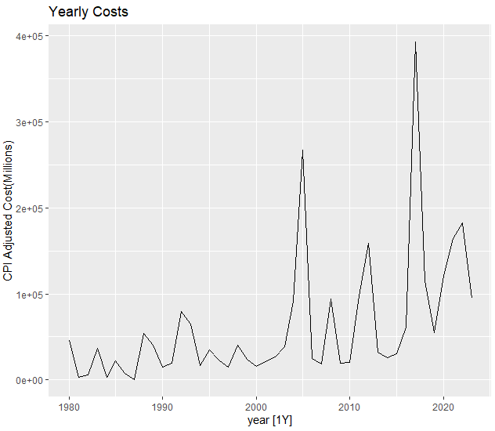
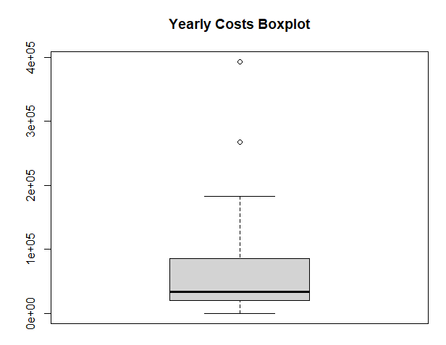
Data Overview – Yearly Costs

Slide 35
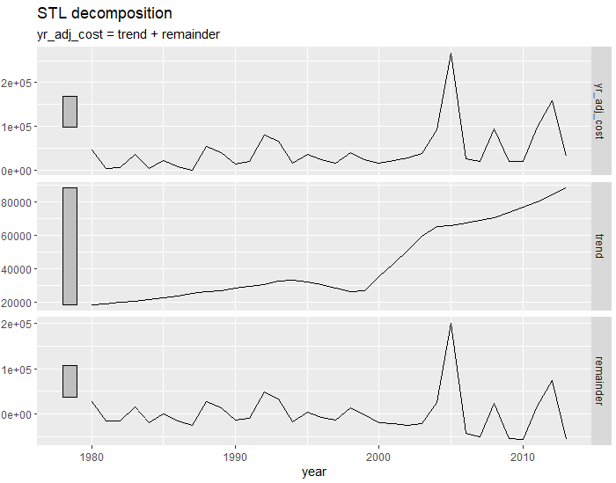
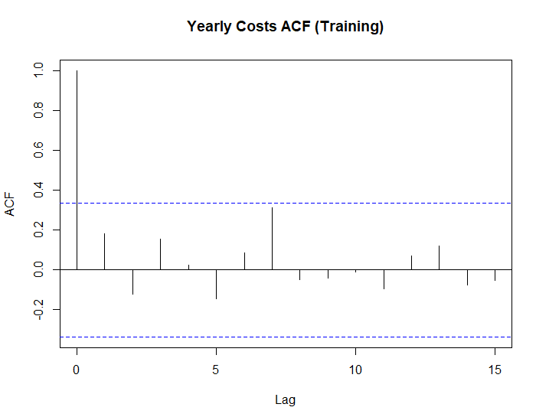
STL Decomposition – Yearly Costs (Training Data)
The data is non stationary because of an upwards trend.
From the ACF, there is no seasonality

Slide 36
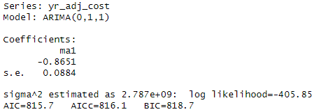
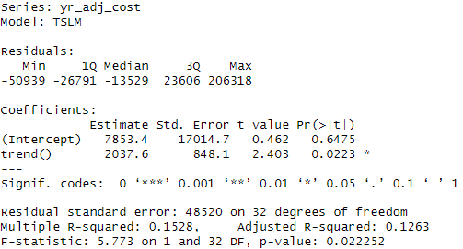
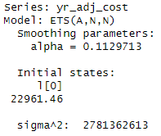
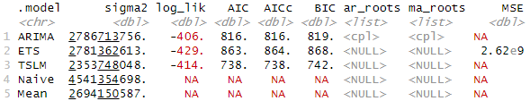
Fitting the models – Yearly Costs (Training Data)
(Simple) Linear Regression
ARIMA
ETS
Results

Slide 37
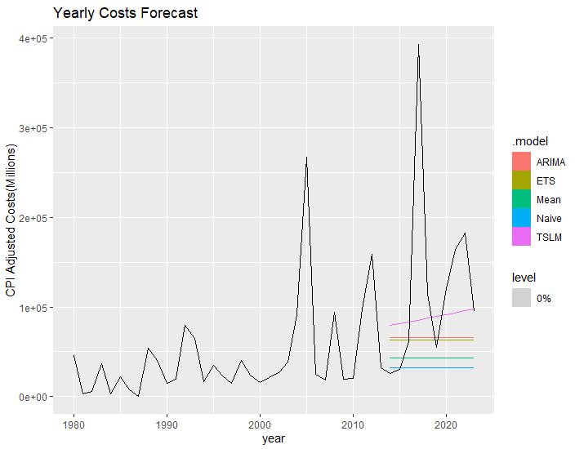
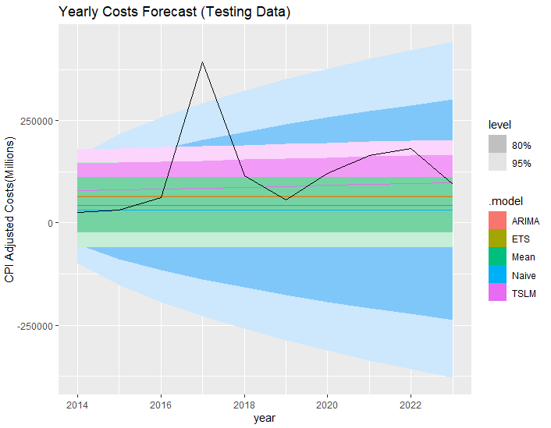
Forecasting – Yearly Costs

Slide 38
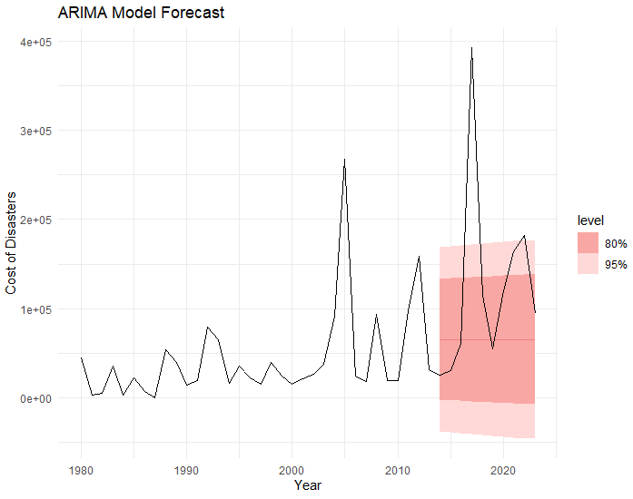
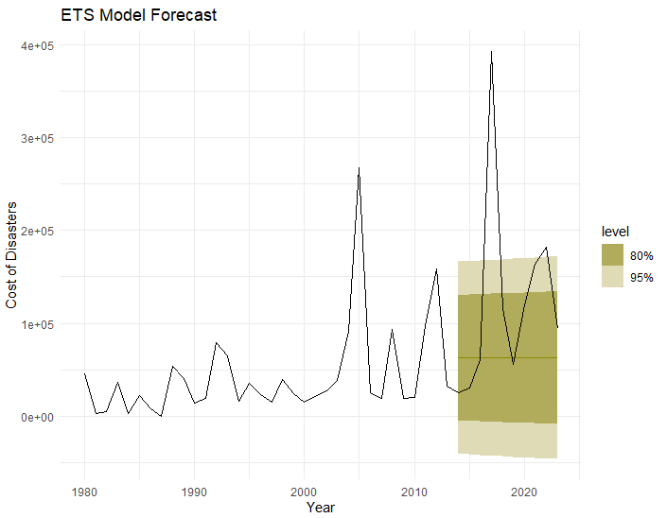
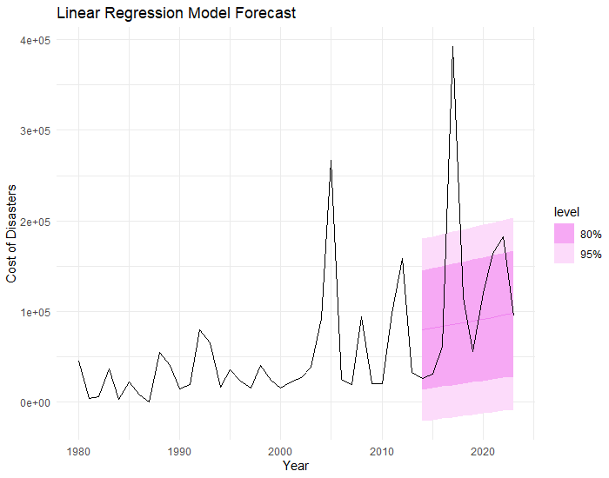
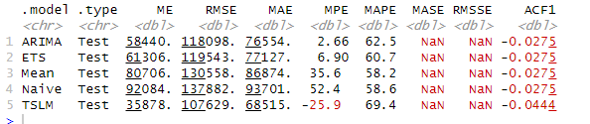
Results: Forecasting – Yearly Costs
Results

Slide 39
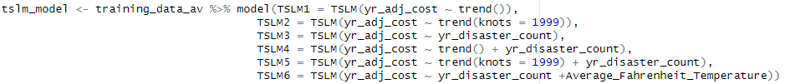
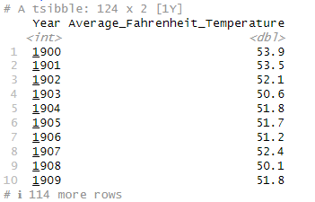
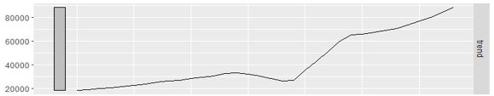
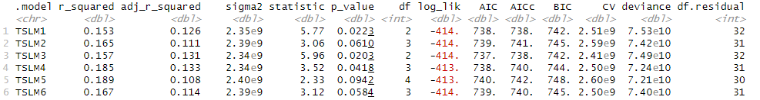
Improving Linear Regression – Yearly Costs
US Temperature Data
Results

Slide 40
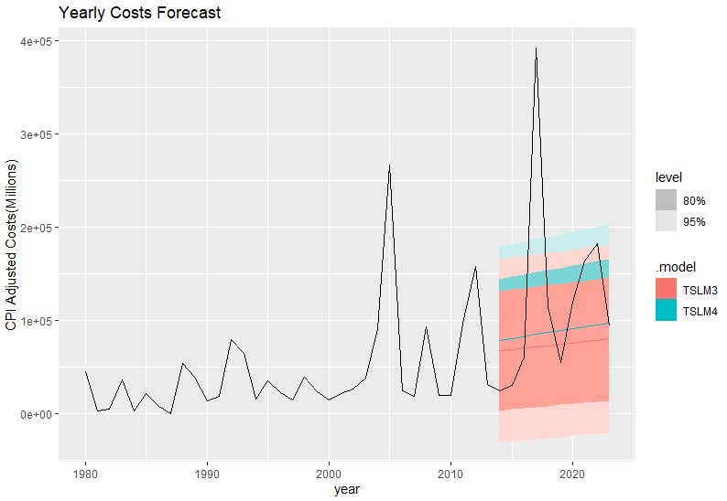
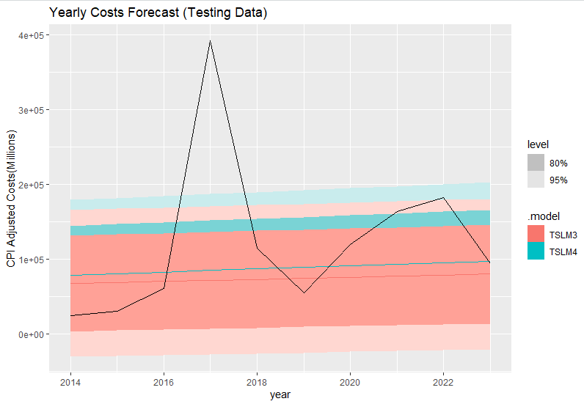
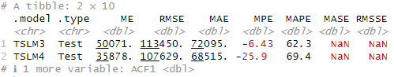
Linear Regression Forecast – Yearly Costs
Results

Slide 41
Conclusion

Slide 42
Monthly Questions
Questions
Seasonality?
Answers
Yes!
Is seasonality changing over time?
Is there a correlation between disaster types and cost?
Depends on the disaster
Yes! Hurricanes
Yes and no!
What times of the year are specific disasters more common?
Notes:
Geography is beyond the scope of this assignment, but is still important to note

Slide 43
Yearly Questions
Answers
No Seasonality/ Upward Trend
Questions
Seasonality / Trend?
Yes!
Hard to Predict!
Can we forecast it accurately?
Can we predict multi-year events?
Is there any correlation between costs and counts?
More Data is needed!
Notes:
Geography is beyond the scope of this assignment, but is still important to note

Slide 44
Thank you for listening!
Any questions?

